Slide 1

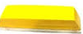
Automatic
Whiteboard/Blackboard Cleaner
C
R
Project members:
Shamali R. Jagadale
Project Guide:
Prof. P. V. Oak
May 2020

Slide 2
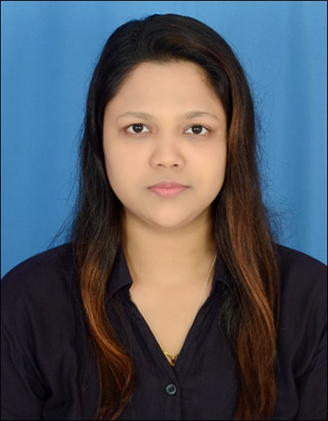
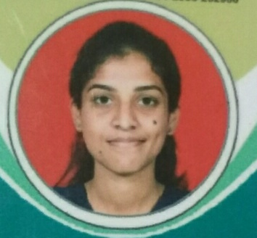

Our Team
Riya M. Doshi
Contact No.:8275485387
Email Id: riyadoshi555@gmail.com
Komal K. Band
Contact No.:8275671665
Email Id: komalband1996@gmail.com
Shamali R. Jagadale
Contact No.:7775984284
Email Id: jagadaleshamali233@gmail.com

Slide 3
Index
Abstract
Introduction
Literature survey
Requirements
Working Strategy
Time Calculation
UML Diagrams
Simulation using Tinkercad.com/Circuits (Phase-I)
Simulation using Breadboard (Phase-I)
Simulation using 3D Gesture Sensor on breadboard (Phase-II)
Final Implementation
Financing Budget
Comparison with current market
Conclusion
Customize the features (Client based)
References

Slide 4
Abstract
Cleaning blackboard or whiteboard consumes a lot of time while teaching we have proposed an automated blackboard or whiteboard cleaning mechanism that cleans the entire board automatically with the help of two modes. This concept uses the two-in-one switch for the two modes selection one for specific portion mode & second for the entire board mode. First is the specific portion mode and second is the Entire board mode. We use duster mounted on rack & pinion which are in connected on a supporting frame this rack & pinion are connected to a rod. We now use a 3DC motor to drive this rack & pinion in the required direction. First DC motor drives the duster forward and backward direction. The second DC motor is to drive the duster in up and down direction and third DC motor is used for the circular direction. So that we get the entire board clean as the frame reaches the other end of the board

Slide 5
Introduction
By the use of this automatic blackboard duster, we can save time and energy.
Our system uses a set of frames, duster, motors, 3D gesture sensor, limit switches, rack & pinion, toggle clamp, DC motors to achieve this mechanism.
Cleaning blackboard or whiteboard consumes a lot of time while teaching we have proposed an automated blackboard or whiteboard cleaning mechanism that cleans the entire board automatically with the help of two modes.
We now use a 3DC motor to drive this rack & pinion in the required direction. So that we get the entire board clean as the frame reaches the other end of the board.

Slide 6
Literature survey
Paper No. | Title of Paper/Publisher | Author of Paper | This is journal/Conference proceeding Date, Month, Year | Relevance to the project
1. | Hand Gesture Recognition using 3D sensors IEEE | Jozef Goga, Slavomír Kajan | Conference paper/ 18-20September2017 | We are using concept of the Hand Recognition using 3D gesture sensors.
2. | The working principle of an Arduino IEEE | Yusuf Abdullahi Badamasi | Conference paper/ 2014 | In this project using both software/hardware Arduino UNO.

Slide 7
3. | Arduino-based Wireless Motion Detecting System IEEE | Siti Syaidatul Syazlina Mohd Soleh, Aida Mustapha | Conference paper/ 2018 | We are using concept of the movements within speciﬁed distance. The Application of Wireless Motion Detection System using Arduino can help users to ensure the safety of their home and properties.
4. | Design on a DC motor speed control. IEEE | Zhu Haishui,Wang Dahu,Zhang Tong,Huang Keming | Conference paper/ 2010 | We designed & built a DC motor controller that operated at very high efficiencies & could be built for a very low price.

Slide 8
Requirements
HARDWARE REQUIREMENT
ATMega328p Arduino: 1
Rod(dia. 16*1250mm) : 2
Linear Bearings : 4
Rectangular Gearbox Motor-150RPM : 1
MG555 12V 60RPM square Gearbox Motor : 2
Stationary base structure
Moving frame with motor mountings & duster mounting
3” Toggle Clamp : 1
PU coated wheels(5cm Dia x 2cm thick) : 6
Rack & pinion(120cm long): 1
Duster : 1
8 Road/Channel Relay Module : 1
Limit Switch : 4
3D Gesture sensor : 1
SMPS 12v : 1
SOFTWARE REQUIREMENT
Arduino IDE
Tinkarcad.com/circuits

Slide 9
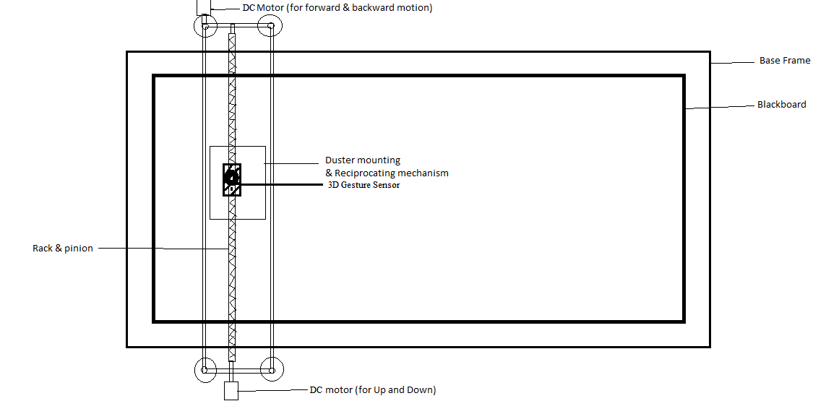
Fig.: Proposed Setup

Slide 10
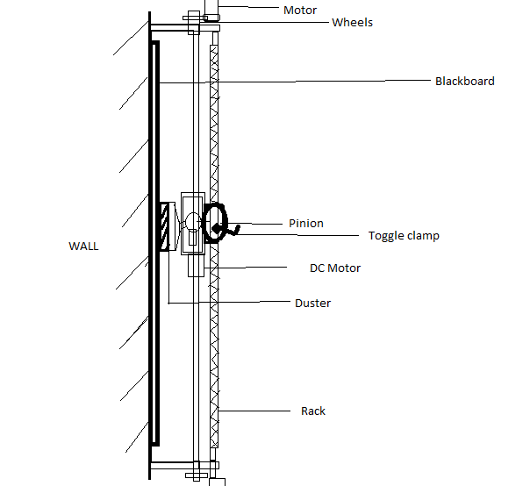
Fig.: Side View

Slide 11
Working strategy
1. User has to switched on the button
2. There are four base frames surrounding a blackboard.
3. The rack & pinion attached on the board and connected with three DC motors.
4. First DC motor travel forward and backward, second DC motor travel top to down and third DC motor used for free travel.
5. Specific Modes:
5.1 Specific portion mode
5.2 Entire board mode
6. In specific portion mode, using 3D Gesture sensor a specific portion on the board will be clean based on the hand movements (movement can be hand motion or single finger). The instruction code is given to the Arduino IDE software.
7. In entire board mode, the entire board is clean in a zigzag motion.

Slide 12
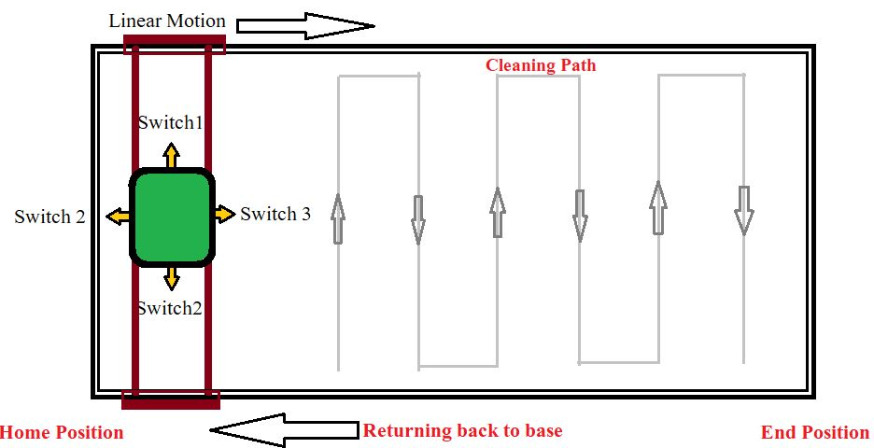
Fig.: System Architecture

Slide 13
Time calculation
Vertical Distance=120cm | Horizontal Distance=360cm (12 feet)
Duster=15cm
120-15=105cm (vertical travelling 105cm)
Horizontal Distance=360cm (12 feet)
Total cleaning board time=2min (tentative)
Total 360cm =15cm *(24 columns)
24 columns in 36sec (1.5 sec per columns horizontally)
Vertical travelling= 105cm in 3.5sec
3.5*24 slots=84sec
Total vertical 84sec + total horizontal 36sec = 120sec for complete cycle.

Slide 14
UML Diagrams
DFD Diagrams (Level 0 and Level 1)
Use Case Diagram
Activity Diagram
Sequence Diagram

Slide 15
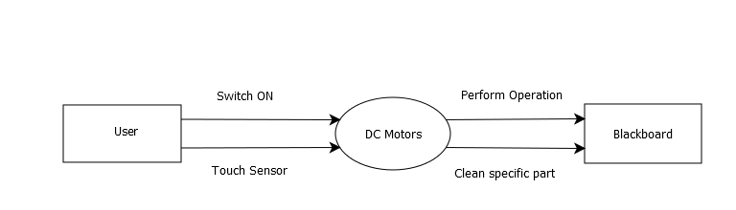
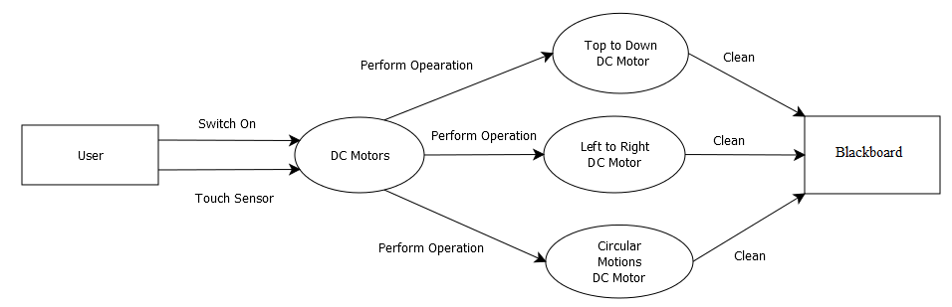
DFD Diagram
DFD Level-0
DFD Level-1

Slide 16
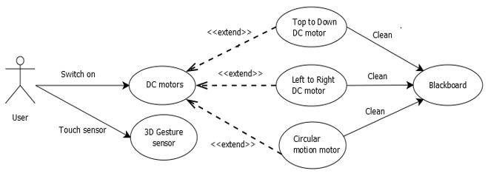
Use Case Diagram

Slide 17
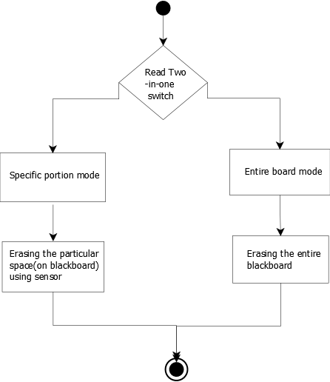
Activity Diagram

Slide 18
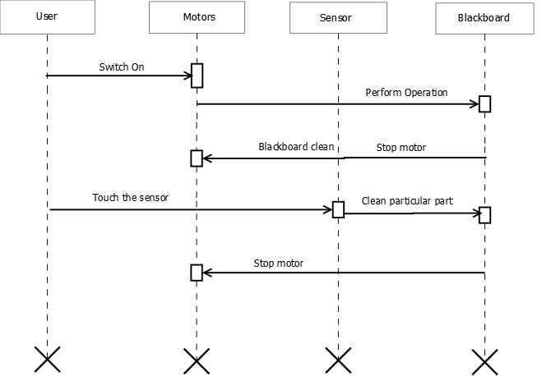
Sequence Diagram

Slide 19
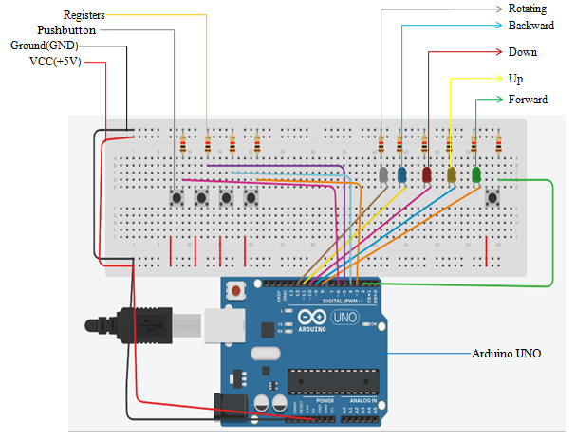
Simulation using Tinkercad.com/circuits
(Phase-I)
1. Connection on breadboard using Arduino, Ground, VCC connection, Pushbuttons(Limit Switches) connections

Slide 20
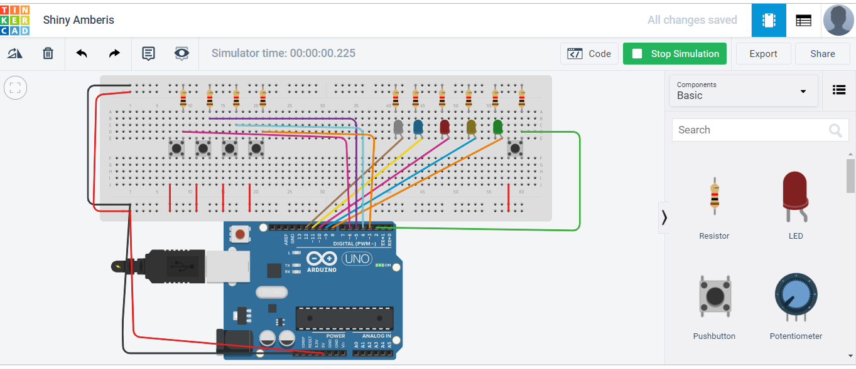
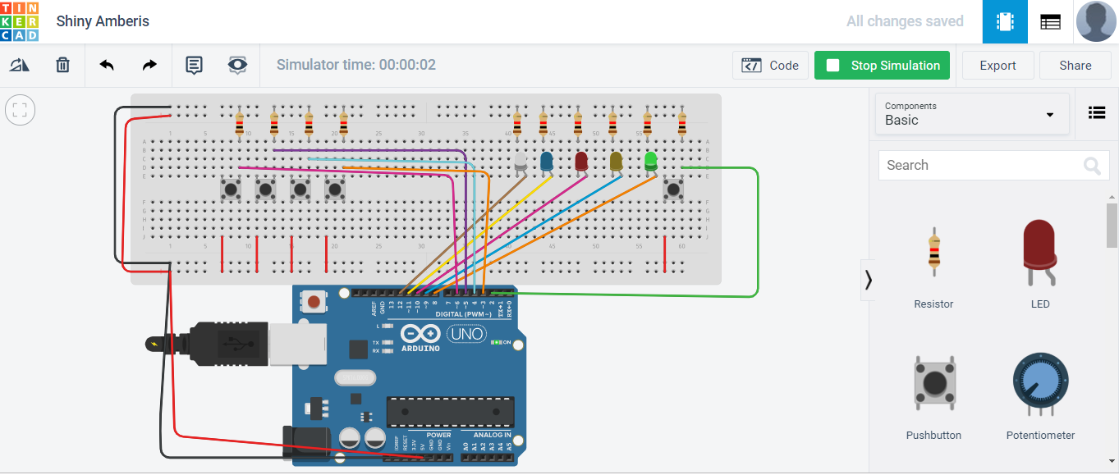
2. Start the simulation
3. After the simulation green and white LED’s are ON(Direction is Forward & Rotating)

Slide 21
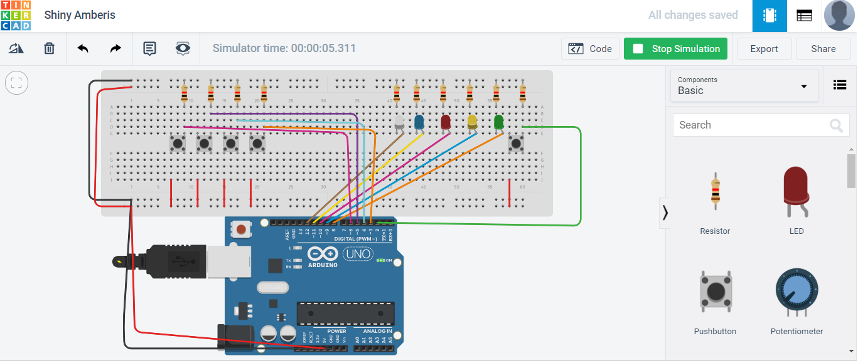
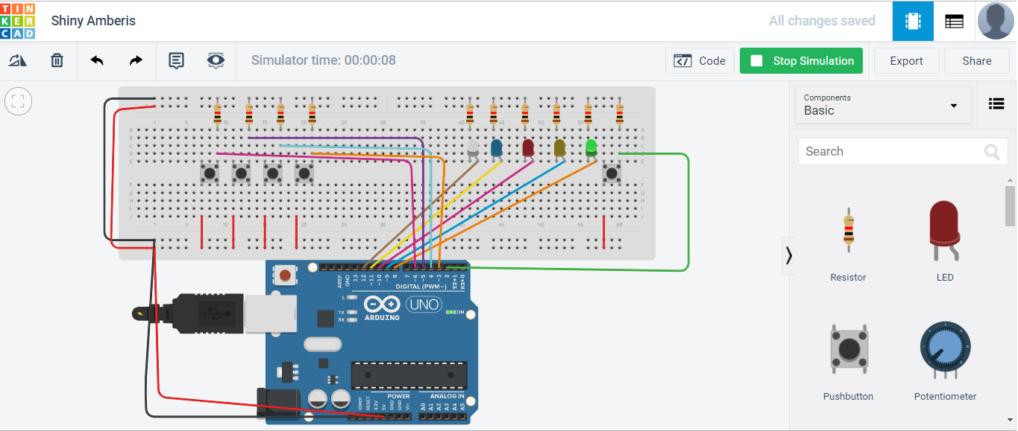
4. Then yellow and white LED’s are ON(Direction is Up & Rotating)
5. Then green and white LED’s are ON(Direction is forward & Rotating)

Slide 22


6. Then red and white LED’s are ON(Direction is down & Rotating)
7. Then blue LED is ON(Direction is backward )

Slide 23

8. At last all LED’s are OFF(Stop the system)

Slide 24
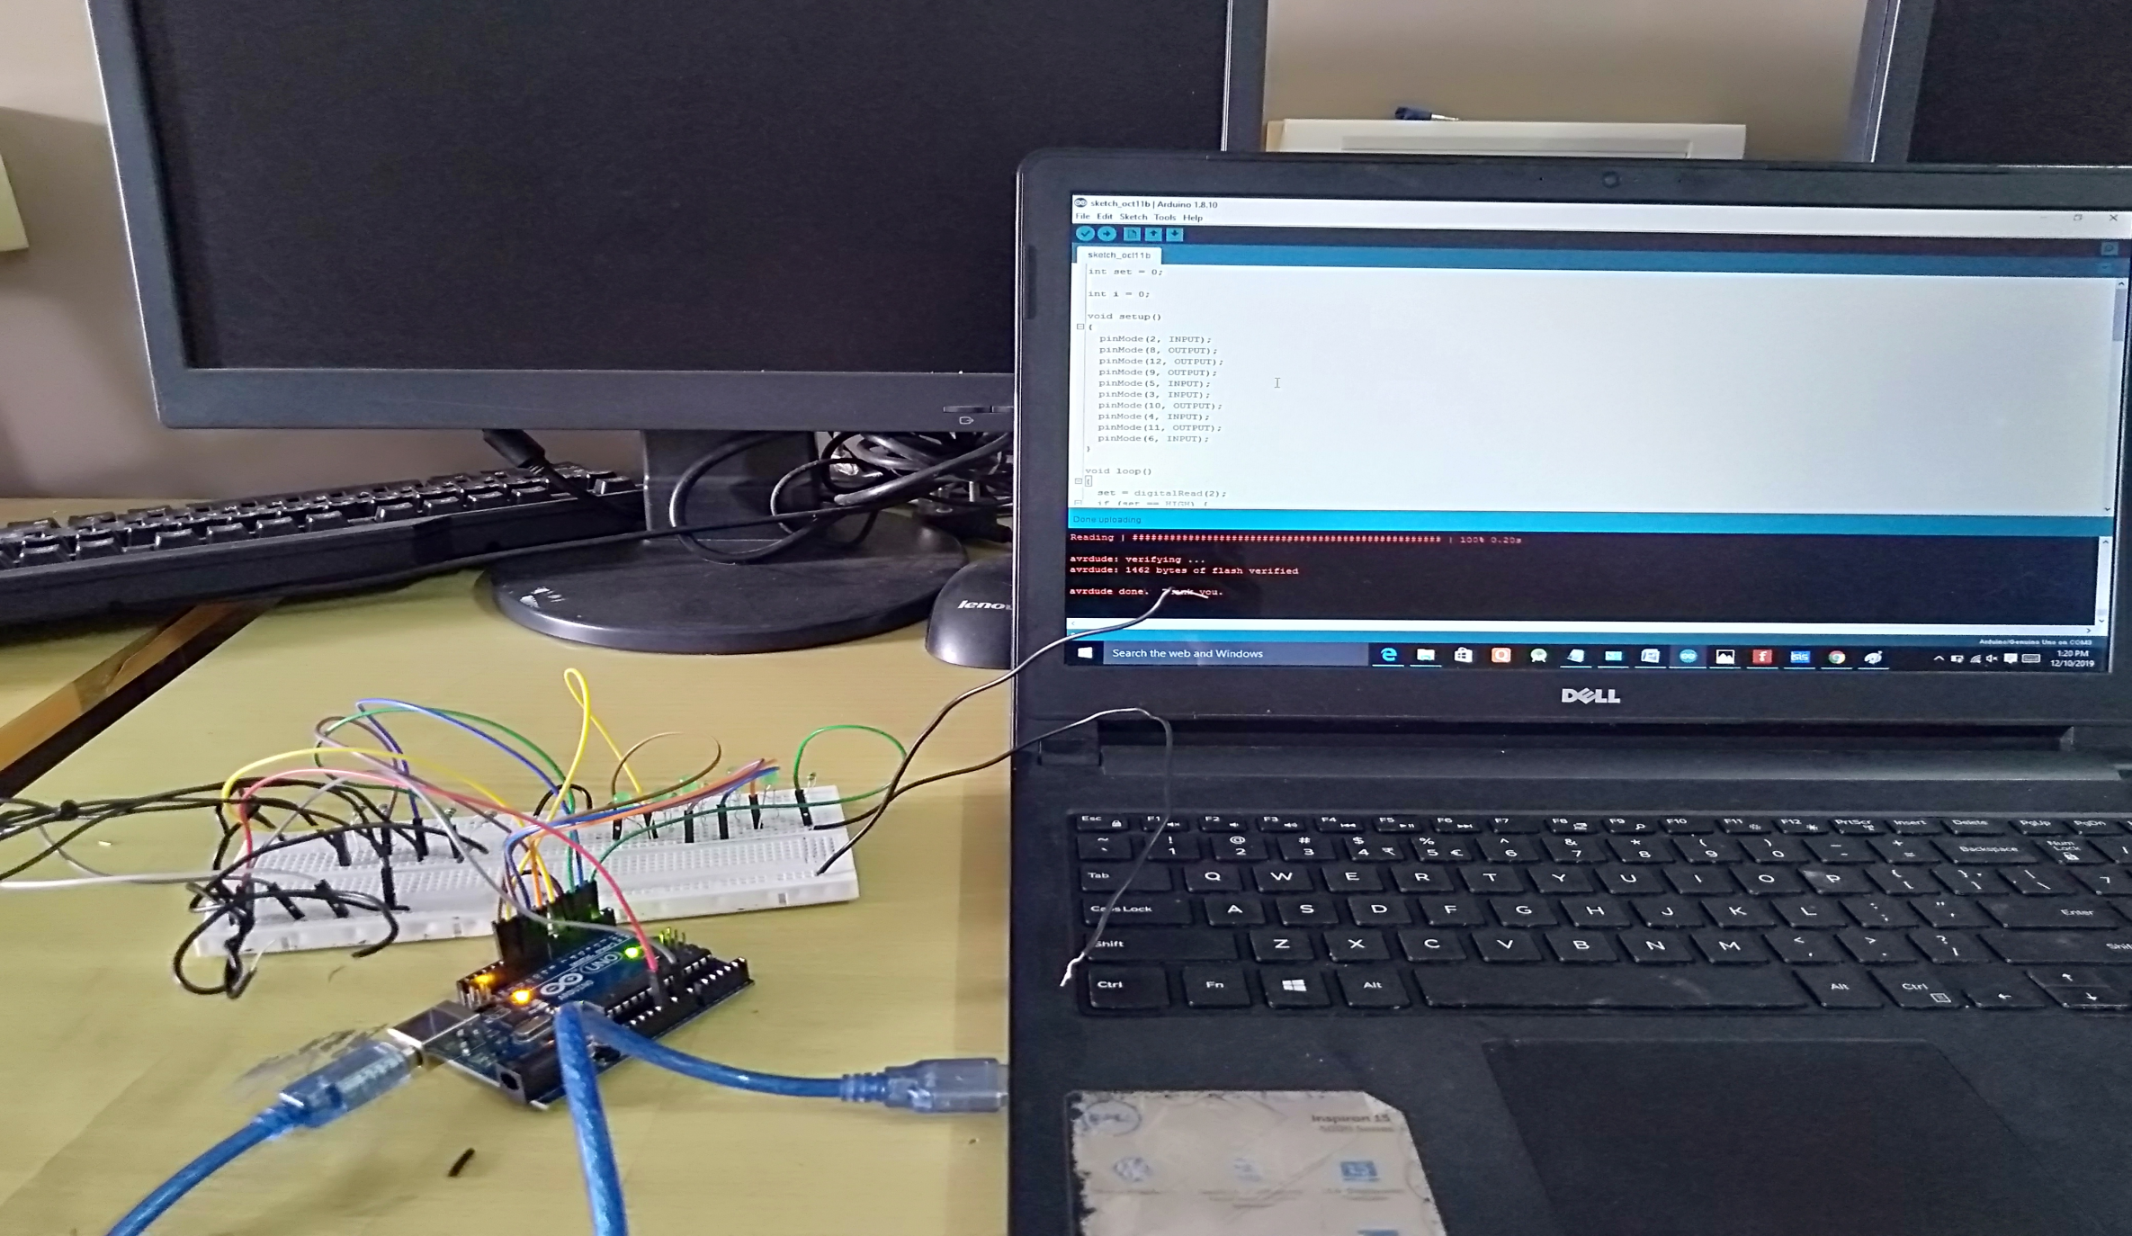
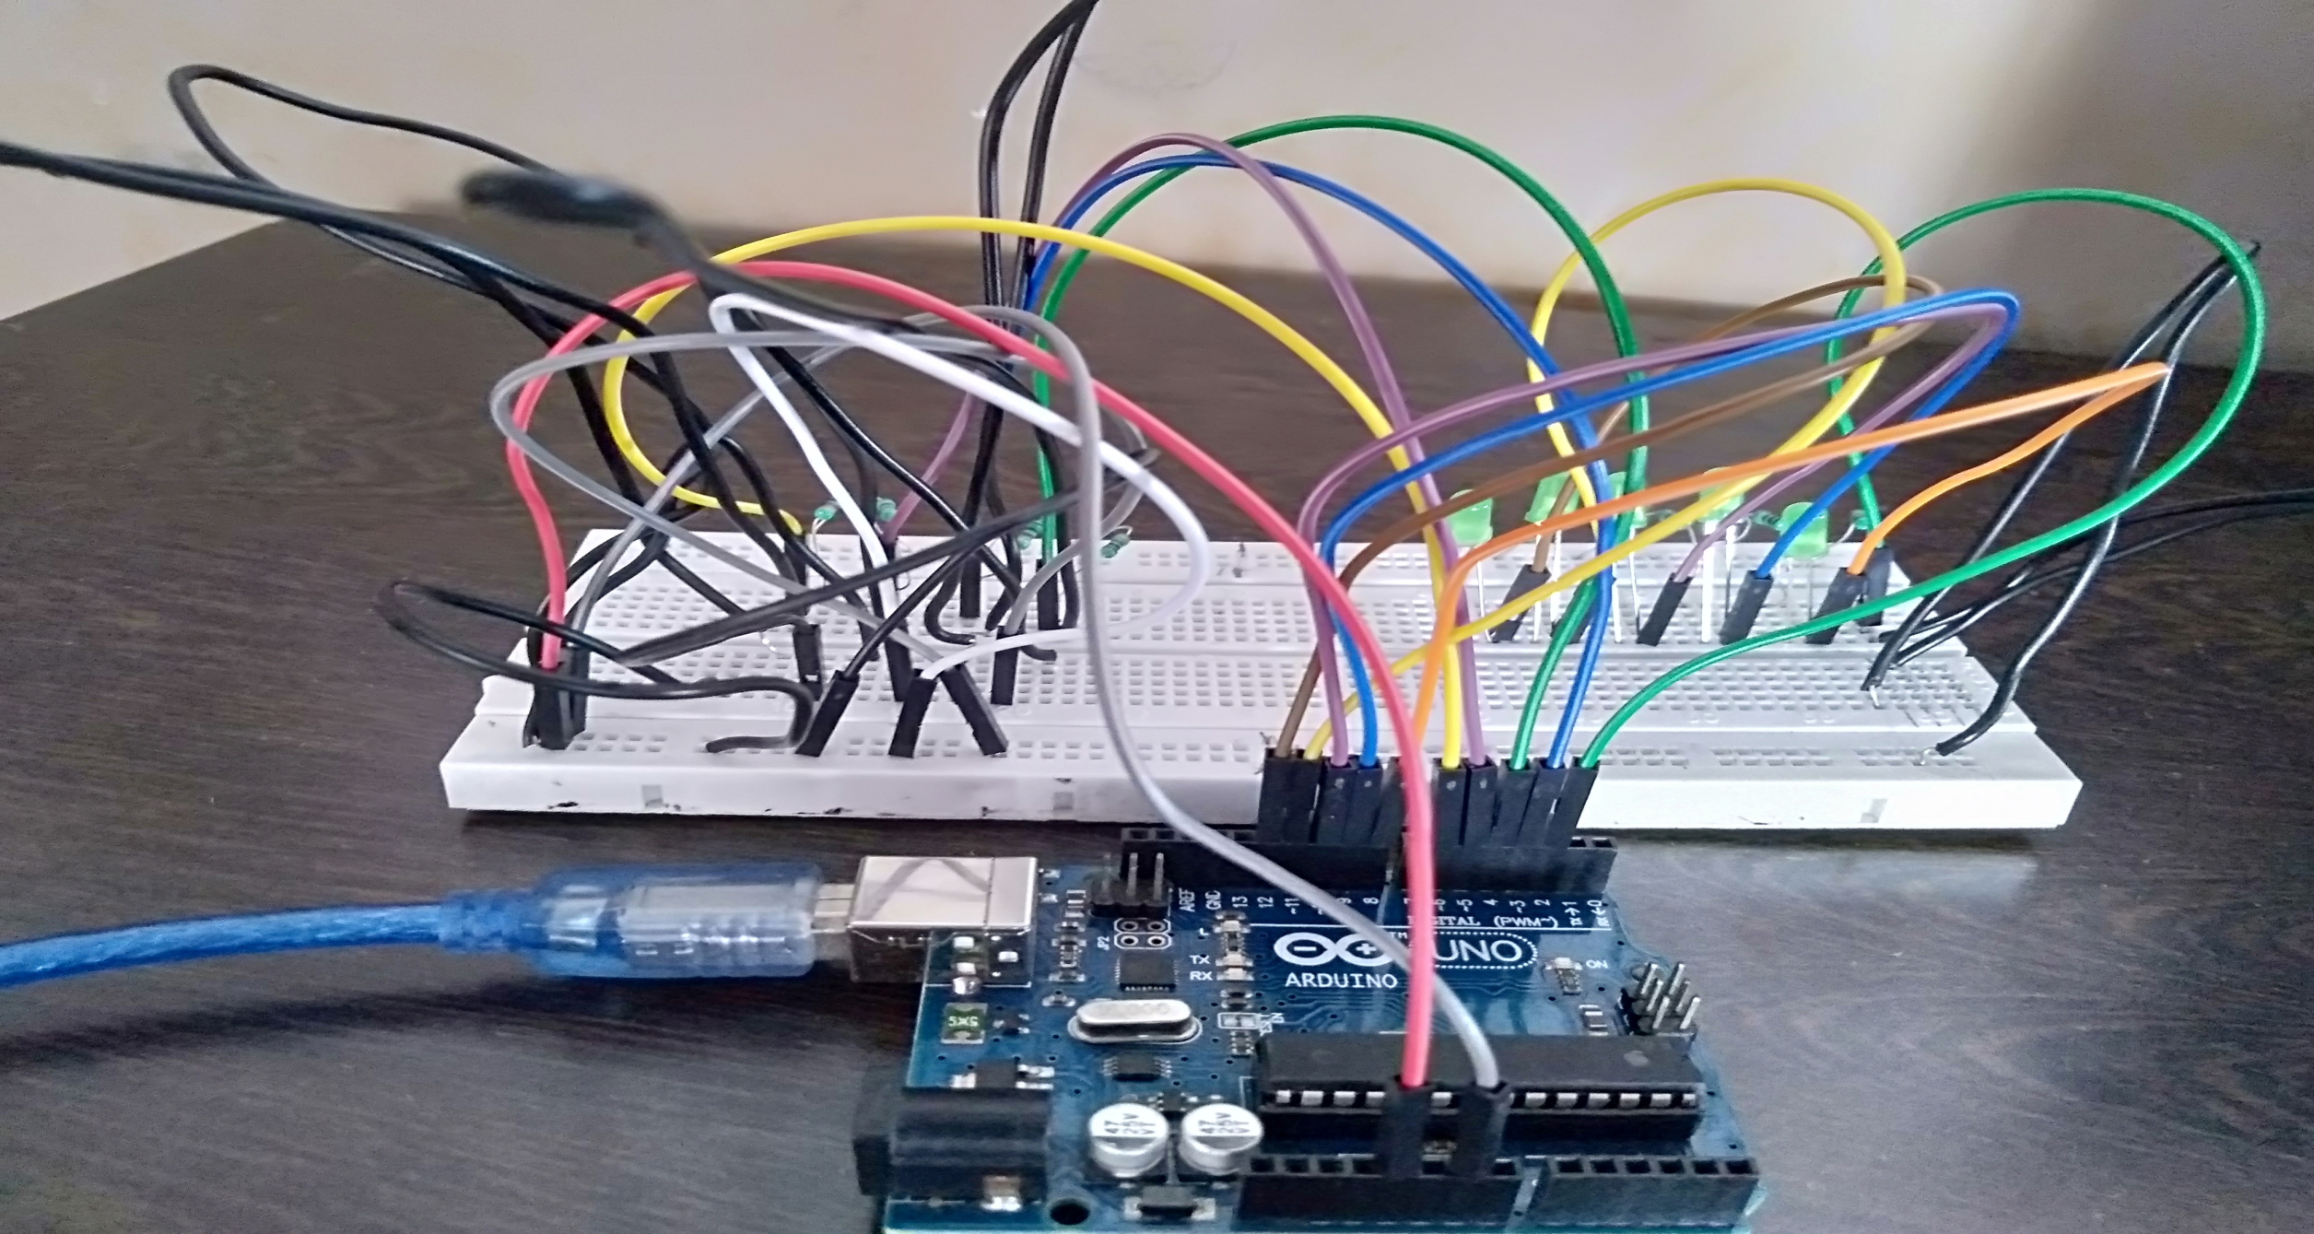
Simulation using Breadboard
(Phase-I)

Slide 25
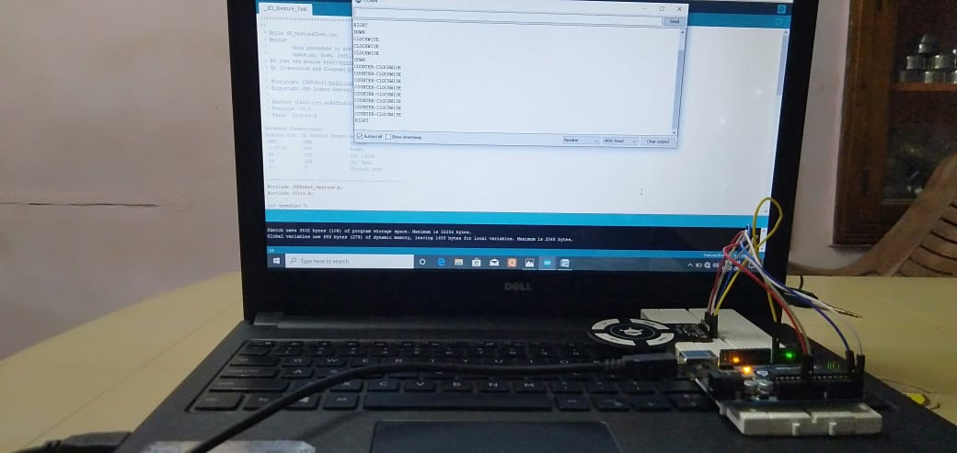
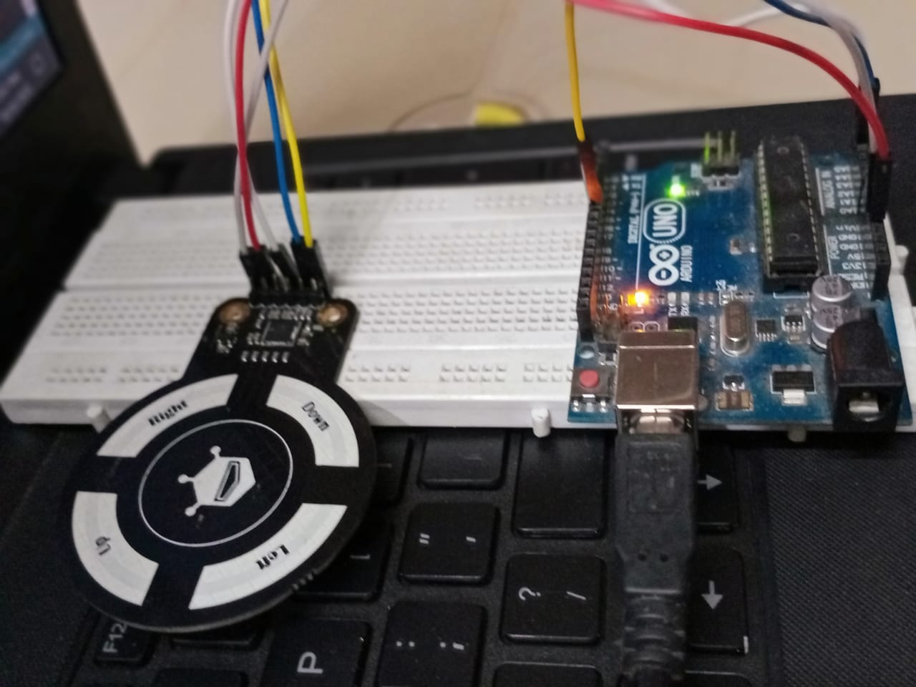
Simulation using 3D Gesture Sensor on breadboard
(Phase-II)
Sensing part

Slide 26
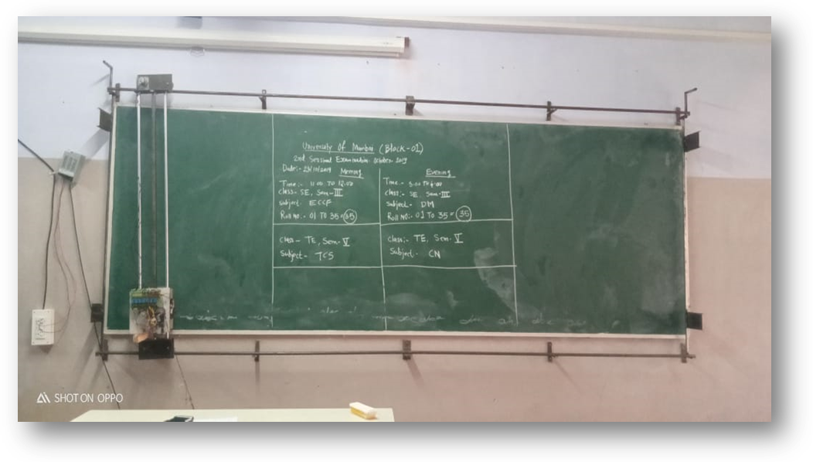
Final Implementation
Fig.: Final implemented system in BE computer classroom of GIT

Slide 27
Financing Budget
Sr. No. | Hardware Name | Quantity | Cost
1. | Rod dia(16*1250mm) | 2 | Rs.1223.66
2. | Uno R3 CH340G ATMega328p Development Board Compatiable with Arduino | 1 | Rs. 299.00
3. | Linear Bearings | 4 | Rs. 517.54
4. | Rectangular Gearbox Motor-150RPM | 1 | Rs. 1281.00
5. | Orange MG555 12V 60RPM square Gearbox Motor for DIY project | 1 | Rs. 1199.00
6. | Orange MG555 12V 60RPM square Gearbox Motor for a DIY project | 1 | Rs. 1199.00
7. | Stationary base structure | 1 | Rs.1600.00
8. | Moving frame with motor mountings & duster mounting | 1 | Rs.1800.00
9. | 3” Toggle Clamp | 1 | Rs.495.00
10. | PU coated wheels(5cm Dia x 2cm thick) | 4*135 | Rs.540.00
11. | Rack & pinion(120cm long) | 1 | Rs.950
12. | Duster | 1 | Rs.50.00
13. | 8 Road/Channel Relay Module(with light coupling)12V | 1 | Rs.576.00
14. | OMRON 3D Printer Limit Switch ENDSTOP SS-5GL | 4 | Rs.276.00
15. | NHP 12V 10A 120W Switch Mode Power Supply(SMPS) | 1 | Rs.1299.00
16. | 3D gesture sensor | 1 | Rs.1521.00
 | Total |  | Rs. 14,826.2/-

Slide 28


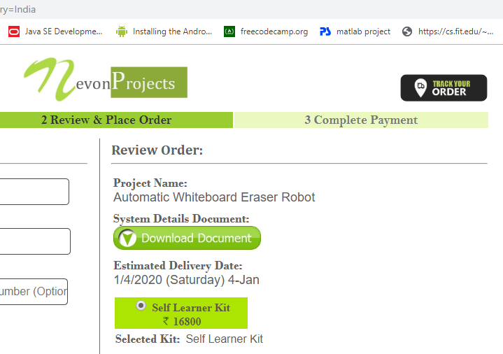
Comparison with Current market
Sr. No. | Parameter | NevonProject (Online Project Buying Side) | Our Project Implementation
1. | Size | 3x3(feet) | 3x3(feet)
2. | Size expansion
3. | Cost | Rs. 16,800/- | Rs. 7,000/-
4. | Customize feature
5. | Partial cleaning

Slide 29
Conclusion
The automatic blackboard duster system has been studied and implemented for cleaning the blackboard automatically. When there is a text written on the blackboard, it automatically cleans the blackboard. It provides a better solution to dust allergy problems form chalk, time constraints in the classroom. The basic methodology is to use DC motors so as to initiate the movement of a duster. Thus, the automatic board duster is also a new technology for cleaning the board automatically in a minimum time period with more effectively. Our purposed the system is very efficient as compare to the literature and provides many add-on features after complete testing with simulation and hardware.

Slide 30
Customized features (Client based)
1. Operate in the schedule – this machine can be set up the time. It can operate automatically when we set up the time we want it to work.
2. Eye of the machine – we can make this machine operate with the detection of dirty in the writing board. The machine knows the location of dirty and erases it automatically.
3. Divide the board in some specific slots (part) and detect where dirt part on the board and clean this particular slots (part) before entering the teachers’ in the classroom.
4. Data Recording – When cleaning the writing board using duster then save the all data on the writing board.

Slide 31
References
[1] J. Goga and S. Kajan, "Hand gesture recognition using 3D sensors," 2017 International Symposium ELMAR, Zadar, 2017, pp. 181-184
https://ieeexplore.ieee.org/stamp/stamp.jsp?tp=&arnumber=8124463&isnumber=8124414
[2] Y. A. Badamasi, "The working principle of an Arduino," 2014 11th International Conference on Electronics, Computer and Computation (ICECCO), Abuja, 2014, pp. 1-4.
https://ieeexplore.ieee.org/stamp/stamp.jsp?tp=&arnumber=6997578&isnumber=6997537
[3] S. S. Syazlina Mohd Soleh, M. M. Som, M. H. Abd Wahab, A. Mustapha, N. A. Othman and M. Z. Saringat, "Arduino-Based Wireless Motion Detecting System," 2018 IEEE Conference on Open Systems (ICOS), Langkawi Island, Malaysia, 2018, pp. 71-75.
https://ieeexplore.ieee.org/stamp/stamp.jsp?tp=&arnumber=8632703&isnumber=8632697
[4] Z. Haishui, W. Dahu, Z. Tong and H. Keming, "Design on a DC Motor Speed Control," 2010 International Conference on Intelligent Computation Technology and Automation, Changsha, 2010, pp. 59-63.
https://ieeexplore.ieee.org/stamp/stamp.jsp?tp=&arnumber=5522813&isnumber=5522297
[5] “Arduino controlled motion sensor,” https://www.instructables.com/id/Arduino-Controlled-Motion-Sensor/, accessed September 21, 2018.
[6] A. G. Smith, “Introduction to Arduino,” published in September, vol. 30, pp. 115–125, 2011.
[7] https://www.tinkercad.com/circuits

Slide 32
THANK YOU

